Slide 1
MealMatch: From Ingredients to Meals
Eshan Kelkar, Quan Nguyen, Pablo Pineda IV, Cameron Yoffe
CSCE 606 - Project 1
Notes:
Howdy! My name is Pablo Pineda IV and I have the privilege of presenting our project, MealMatch: From Ingredients to Meals.

Slide 2
The Application - Who & What
Client/End-users:
Home Cooks: anyone looking to cook with leftovers/ingredients they already have
Meal Planners: just anyone looking for inspirations for their next meals
Notes:
This application is designed to be used by Home Cooks and Meal planners.

Slide 3
The Application - Who & What
What problems does it solve?
Helps users search for recipes tailored to their ingredient lists.
Reduces household food waste by helping users utilize existing pantry items.
How does it solve those problems?
Allows users to create and manage multiple ingredient lists.
Connects to TheMealDB API to find recipes based on your list(s) of ingredient(s).
Facilitates streamlined discovery: a Tinder-like swiping interface makes browsing recipes fast and engaging.
Allows users to save favorite recipes for easy access later.
Notes:
Have you ever looked into a full pantry and not know what to make for dinner? Or looked into a pantry with scrap ingredients and wondered what you can make of it? MealMatch is here to help you be creative with the ingredients you have at hand. The idea is that you provide the app with a list of ingredients and it will compile multiple recipes from TheMealDB’s database for you to choose from in a Tinder-like fashion. You can then save any recipes you like so that you can have access to them from anywhere on your account.

Slide 4




System Design - Key Components
Frontend: HTML/ERB views, Stimulus.js for interactive modals
Backend: Ruby on Rails MVC framework.
External Service: TheMealDB API for ingredient and recipe data.
Database: PostgreSQL
Notes:
Typical Model View Controller Architecture discussed in class, with mealDB API used as a external service.

Slide 5
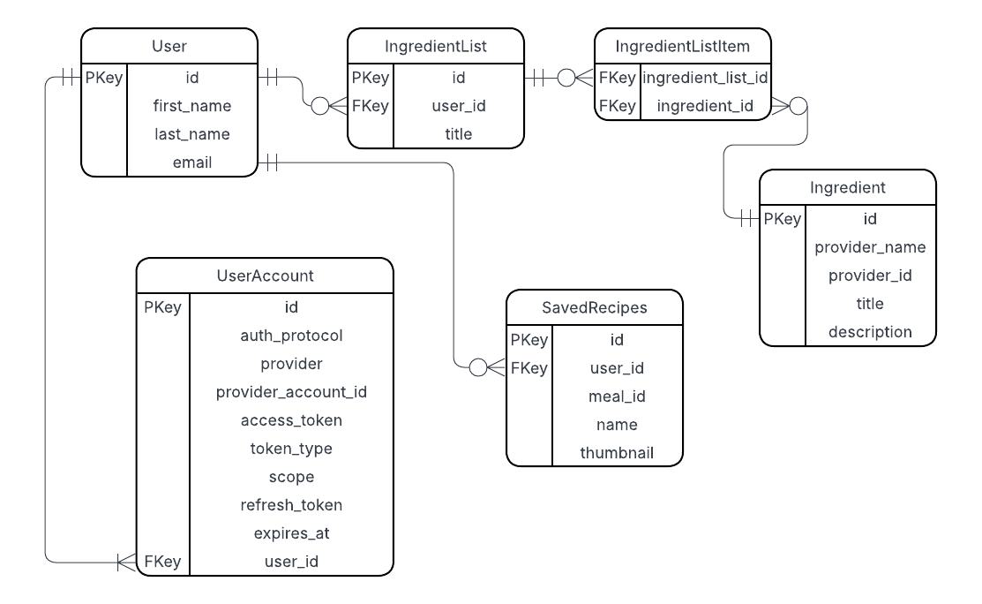
Database Design Diagram
Notes:
The database model captures the idea that users can create multiple ingredient lists, each of which may have multiple ingredients. Using those ingredient lists, user can search for recipes and save multiple recipes for reuse.

Slide 6
Database Design Model (in words)
One to many relationship between User and User Account
One to many relationship between User and IngredientList
Many to many relationship between IngredientList and Ingredient
One to many relationship between User and SavedRecipes
Notes:
(Repitition of what was explained before in the diagram)

Slide 7
Frameworks & Tools Used
Ruby on Rails: Model View Controller Framework
PostGreSQL: Relational Database System
Rspec for unit tests
Cucumber for acceptance tests
Capybara for system tests
Stimulus JS for making ingredient search UI more accessible

Slide 8


Design Patterns Used
MVC (Model-View-Controller): Core Rails pattern for separation of concerns.
Service Object Pattern: MealDbClient encapsulates all external API logic, keeping controllers thin.

Slide 9
System Design - Major Design Choices & Justification
Choices | Justifications
Progressive Enhancement / No-JS Fallback | Ensures core functionality (managing lists, searching) works for all users, regardless of JavaScript availability. This improves accessibility and reliability.
Standalone MealDbClient Service | Isolates external API dependencies. Makes testing easier (via stubbing) and allows for easy swapping of the recipe provider in the future.
Reuse Ingredients | Prevents data duplication. All ingredients lists reference the same ingredient record, ensuring consistency and saving storage.

Slide 10
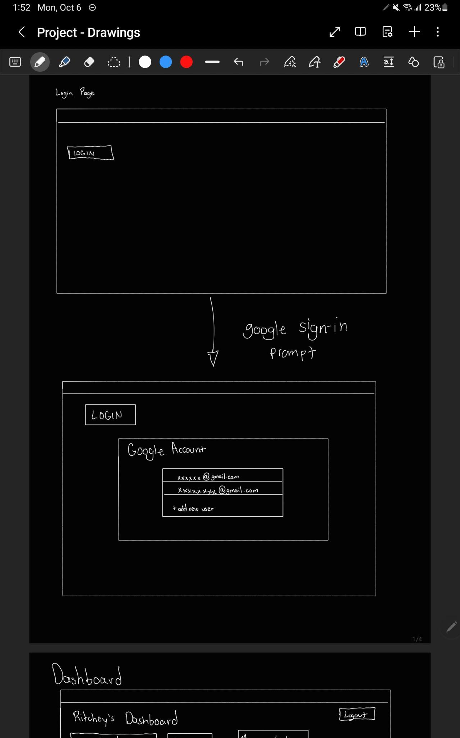
Login Page
Notes:
Using the login page, users can log into meal match via their google account.

Slide 11
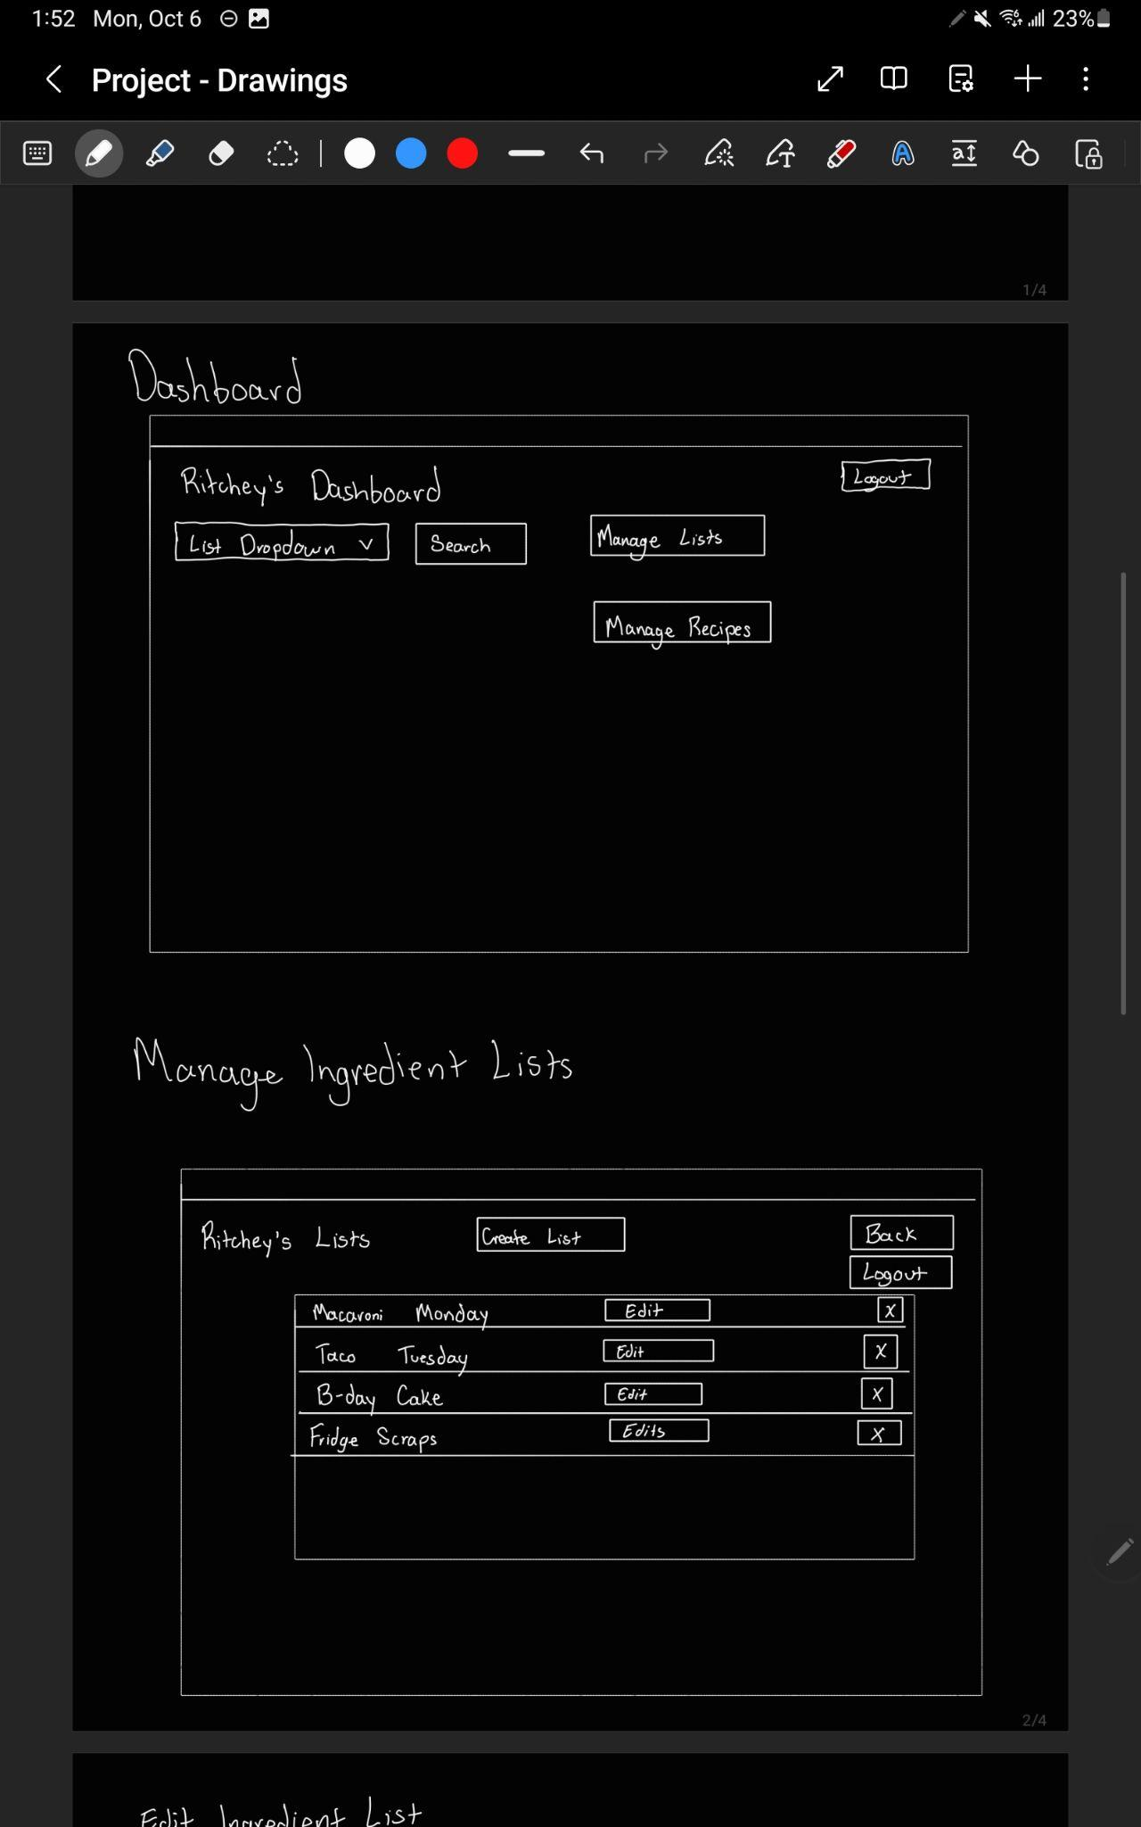
Dashboard
Manage Lists
Notes:
The dashboard is a central system that connects to all the parts of meal match, namely ingredient list management, recipe search and saved recipe management.

Slide 12
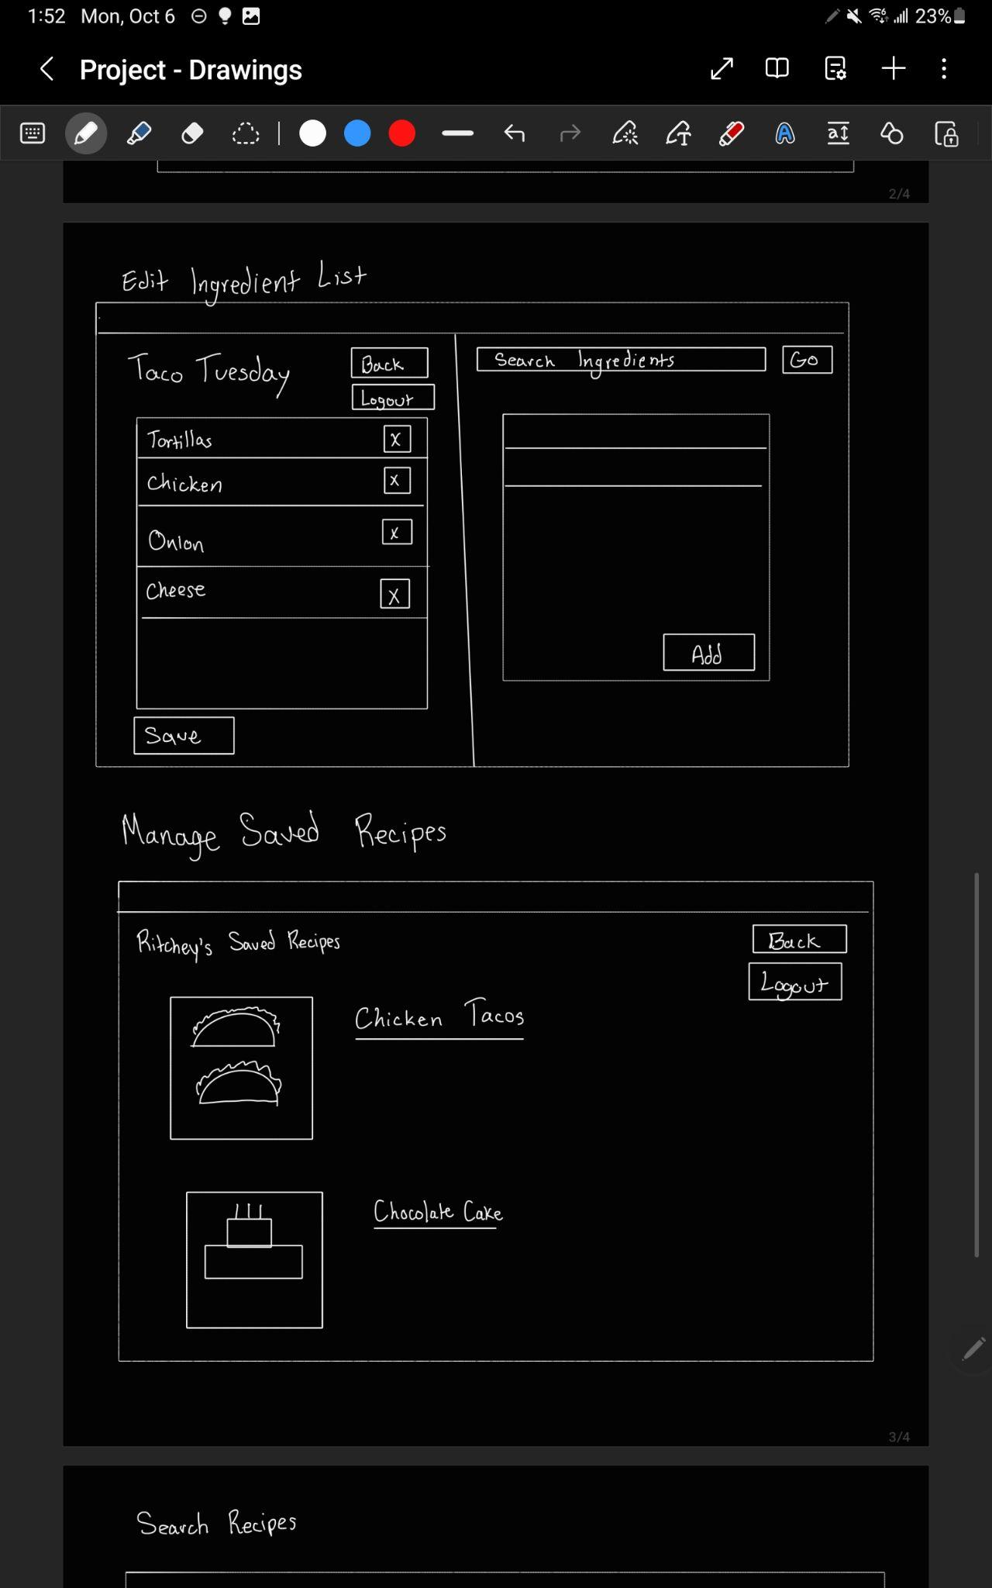
Edit List Page
Manage Saved Recipes

Slide 13
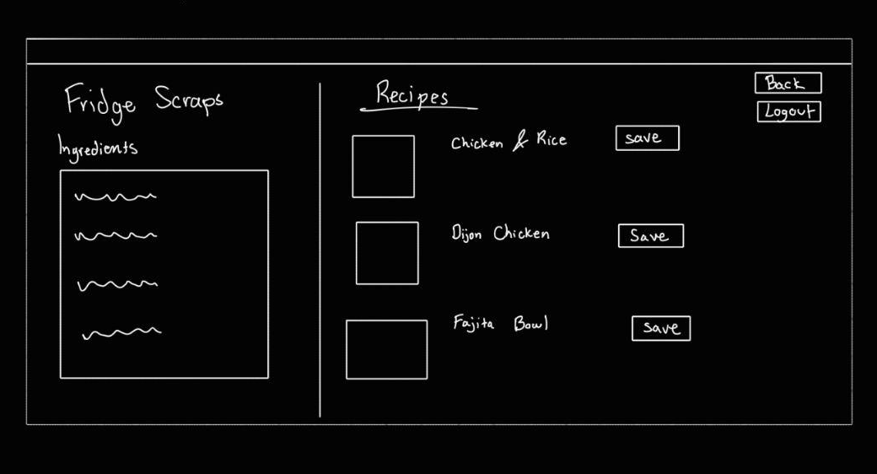
Search Recipes Page

Slide 14




UI/UX Design - Design Principles Applied
Separate Pages for each developer’s features: Allows developers to work independently speeding up the development.
Seamless Navigation: "Back to Dashboard" and "Logout" buttons are consistently available.
Consistency: Uniform button and modal styles throughout the app.
Elaborate only what user likes to see: The Tinder-like swipe interface allows user to view in details only the recipes that user shows interest in
Notes:
For this project we decided to make separate pages for our app. This made it easier for us to split work between us. We made navigation easy by including “Back to dashboard” and “logout” buttons.

Slide 15
AI Tool Usage
– ChatGPT:
Code Explanation & Debugging: To understand complex error messages and suggest fixes for RSpec and Cucumber tests.
Boilerplate Generation: For generating standard Rails controller actions and model specs.
Documentation Assistance: To help draft initial YARD comment blocks and ensure consistent formatting across files.
Idea Validation: For inquiring about the idiomatic way of doing stuff in ruby.
– Copilot, Codex:
Code Completion: Accelerated writing repetitive code in views, tests, and model associations.
Notes:
Guided us with speeding up implementation, debugging and helped us discover idiomatic ways of achieving our goals in rails.

Slide 16
Challenges & Lessons Learned
– Challenge 1: API Integration & Mismatch:
Problem: Initial Sprint 1 slowdown due to using two different APIs (FDC for ingredients, TheMealDB for recipes) with incompatible data models.
Lesson: Via communication, thoroughly vet and commit to consistent external APIs early in the project lifecycle.
– Challenge 2: Team Coordination:
Problem: Large Pull Requests made reviews difficult and increased merge conflict resolution time.
Lesson: Enforce smaller, more focused PRs and branch per feature. Increased frequency of in-person syncs dramatically improves integration speed and design cohesion.

Slide 17




Future Plans & Opportunities
Enhanced Filtering: Add dietary restrictions (vegan, gluten-free) and cooking time filters.
Social Features: Allow users to share their ingredient lists and saved recipes with friends.
Grocery Integration: Generate a shopping list for missing ingredients, potentially linking to online grocery services.
Mobile App: Develop a native mobile app using the rails backend as an api to improve the on-the-go experience.

Slide 18
Thanks & Gig’Em

